Slide 1
Consumer price index

Slide 2
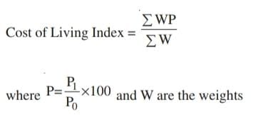
Consumer price index
A consumer price index (CPI) measures changes in the price level of a basket of consumer goods and services purchased by households. CPI measures changes in the price level for the specified consumers in the particular region.

